Slide 1
Xamarin and Azure Storage

Slide 2
What are we talking about
What is Azure Storage
Blob Storage
Demo

Slide 3
Azure Storage
Cloud storage. Can be used to store structured and unstructured data

Slide 4
Four storage services
Blob storage- text or binary data
Table storage- NoSQL key attribute store.
Queue storage – Messaging service for workflow processing and communication.
File storage – Shared file storage

Slide 5
Two types of storage accounts
General purpose storage account- provides access to all storage accounts.
A blob storage account- specialized storage account for storing blobs.

Slide 6
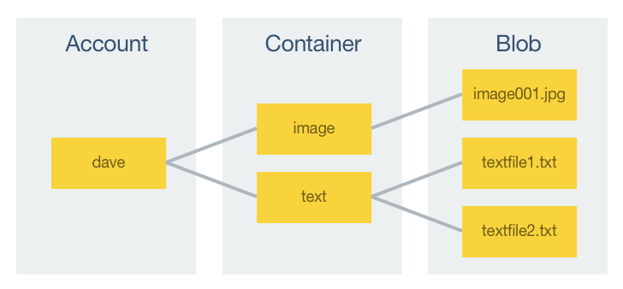
Blob storage

Slide 7
Blobs
A blob is a file of any type and size. Azure supports three different blob types:
Block blobs are optimized for streaming and storing cloud objects, and are a good choice for storing backups, media files, documents etc. Block blobs can be up to 195Gb in size.
Append blobs are similar to block blobs but are optimized for append operations, such as logging. Append blobs can be up to 195Gb in size.
Page blobs are optimized for frequent read/write operations and are typically used for storing virtual machines, and their disks. Page blobs can be up to 1Tb in size.

Slide 8
Blob storage accounts support block and append blobs, but not page blobs.
A blob is uploaded to Azure Storage, and downloaded from Azure Storage, as a stream of bytes. Therefore, files must be converted to a stream of bytes prior to upload, and converted back to their original representation after download.
Every object that's stored in Azure Storage has a unique URL address.

Slide 9
Demo

Slide 10
Resources
Code: https://github.com/xamarin/xamarin-forms-samples/tree/master/WebServices/AzureStorage
https://developer.xamarin.com/guides/xamarin-forms/cloud-services/storage/azure-storage/
https://developer.xamarin.com/samples-all/

Slide 11
Yair Segal
ysegal@mypeachsoftware.com
Peach Software Inc
www.mypeachsoftware.com

